Slide 1
Styles and Designs
Kai$ha

Slide 2
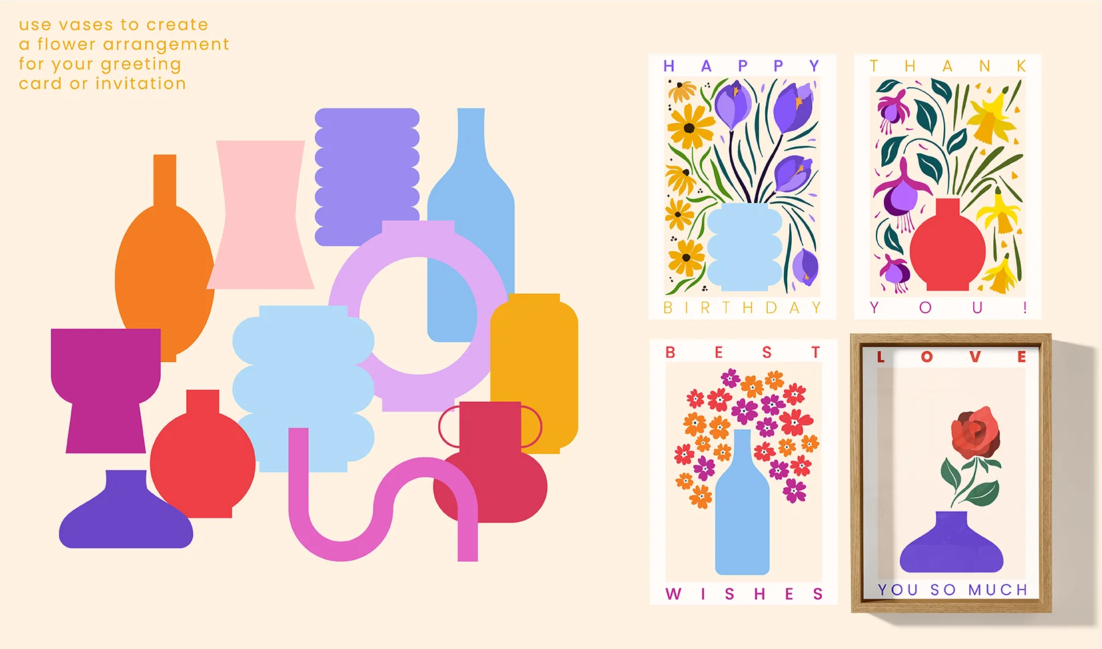
Contemporary graphic design style

Slide 3
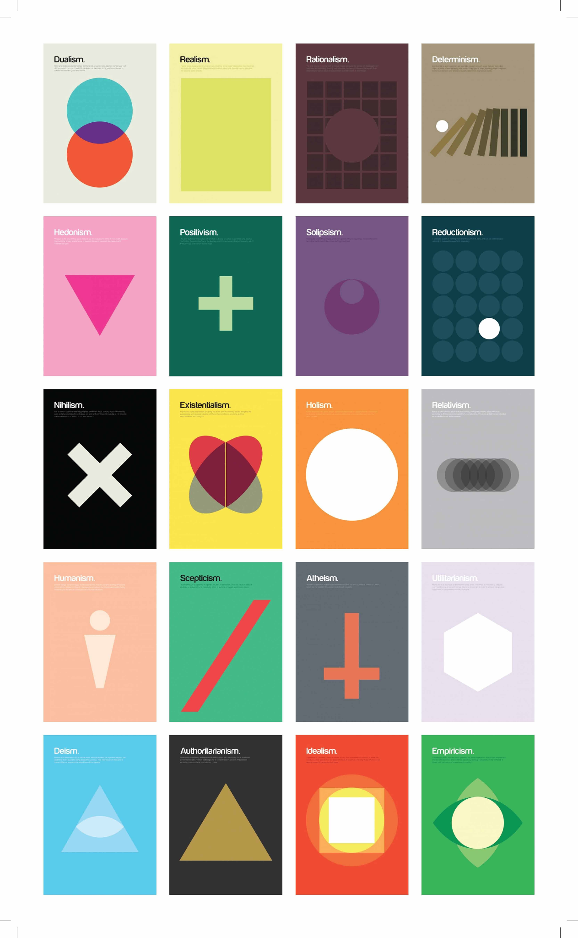
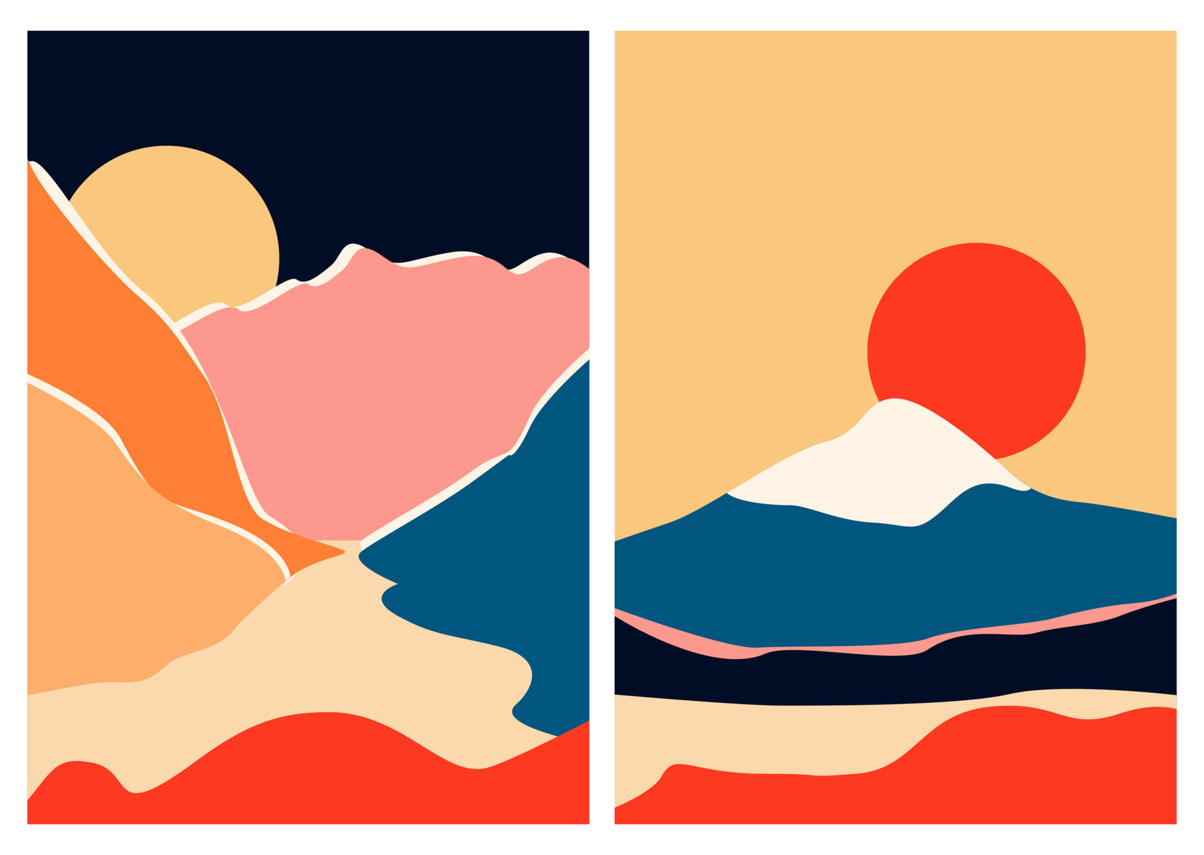

Minimalist graphic design style

Slide 4


Flat graphic design style

Slide 5
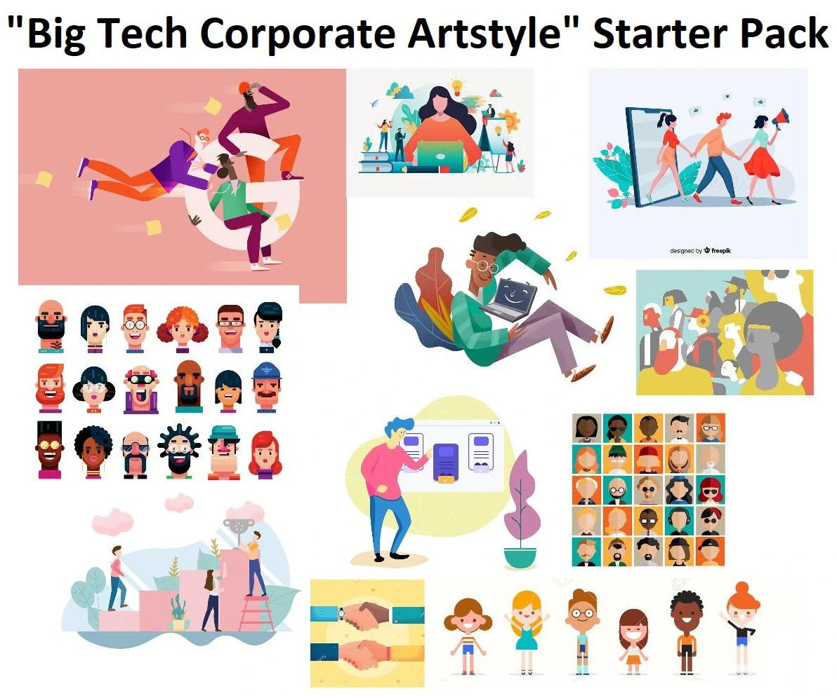

Corporate Memphis design style

Slide 6
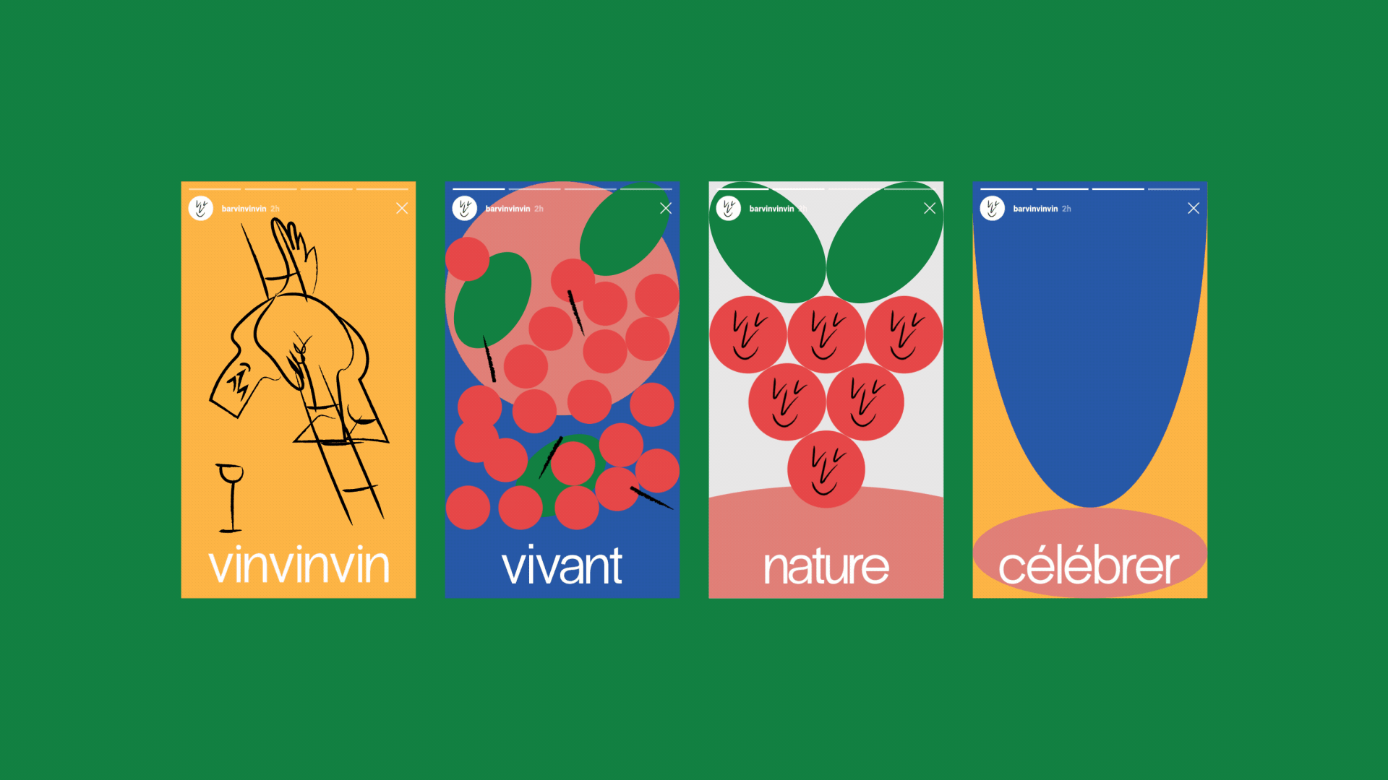
Ideas and examples:

